Slide 1
HACK THE ELECTIONS

Slide 2
WHAT HAPPENS?

Slide 3
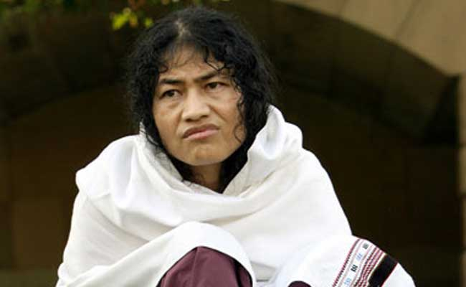
IROM SHARMILA

Slide 4
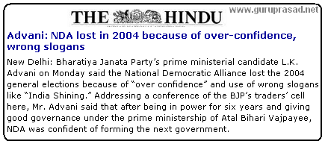
BJP lose elections 2004:
SHINING INDIA

Slide 5
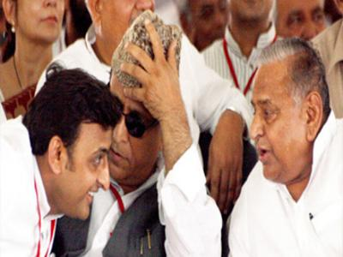
UP ELECTIONS : BJP SWEEPS

Slide 6
PROBLEM

Slide 7
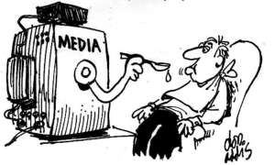
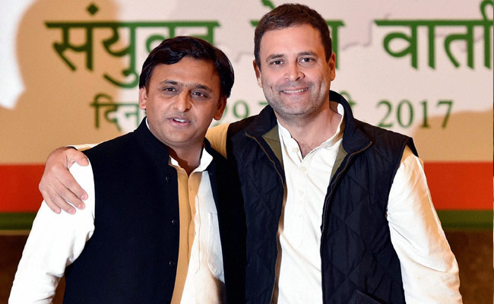
MEDIA OVERPOPULARIZE POLITICAL PARTY

Slide 8
THE IDEA

Slide 9
WHAT WE TRACK
TRACK TWEETS BY CANDIDATES, PARTY
TRACK NEWS AGENCIES
TRACK PUBLIC OPINIONS ABOUT THE CANDIDATES AND PARTIES

Slide 10
What We get
sentiment analysis of public
Sentiments shared by parties and candidates.
POPULARITY

Slide 11
OUTPUT
Opinion about the candidate
Opinion about the Party
Impact of tweets on the election results
SCORE PERCENTILE PER CANDIDATE =
(TWEETS + MEDIA + RETWEETS + SHARES )

Slide 12
WHAT WE INFER
How candidates should interact with media
The way resources can be used per constituency
The Trends : sentiments analysis vs the election results
Check in real time

Slide 13
TECHNICAL

Slide 14
FEATURE
LOCAL
STATE
NATIONAL

